Slide 1
DevConnections Protecting your data with encryption while maintaining performance in SQL Server 2014
Steve Jones
sjones@sqlservercentral.com
@way0utwest
www.voiceofthedba.com

Slide 2
Agenda
Who am I?
Setting expectations
The basic story of encryption
Encrypting communications
Easy transparent encryption
Better performing queries on encrypted data

Slide 3
Introduction
Steve Jones
Editor and Founder, SQLServerCentral
Evangelist, Red Gate Software
23 years experience with SQL Server
Contact
@way0utwest (Twitter)
http://www.linkedin.com/in/way0utwest
www.voiceofthedba.com
SQLServerCentral (sjones@)

Slide 4

Notes:
One day your boss comes in and say that he needs you to encrypt things in your database infrastructure.

Slide 5
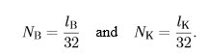
Research
Notes:
You start learning encryption

Slide 6
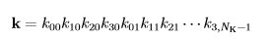
Research
Notes:
There are complex formulas with polynomial expansions

Slide 7
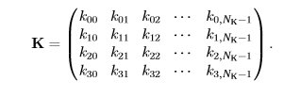
Research
Notes:
And matrices

Slide 8
Research
Notes:
With ring operations

Slide 9
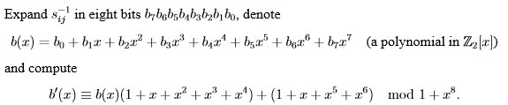
Research
Notes:
And more polynomials

Slide 10
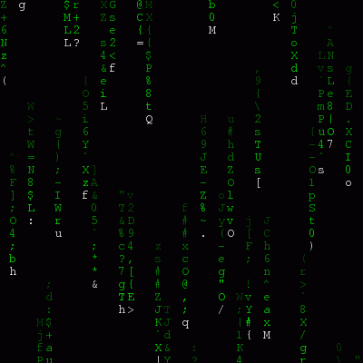
Research
Notes:
Eventually things are blurring together and it seems this encryption stuff is really, really complex.

Slide 11
Research
plain text -> F(x) -> encrypted text
Notes:
You realize that it’s just as simple as taking your text, running it through a function and getting encrypted results.

Slide 12
Research
plain text -> F(x) -> encrypted text
encrypted text -> F(x) -> plain text
Notes:
You realize that it’s just as simple as taking your text, running it through a function and getting encrypted results.

Slide 13
Research
Declare @MyJobIsSafe varbinary(max)
, @cc varchar(16)
Select @cc = ‘4111111111111111’
Exec @MyJobIsSafe = UDF_EncryptData(@cc)
Notes:
So you build some code to test encryption, and you end up with something like this:

Slide 14
Research
Declare @MyJobIsSafe varbinary(max)
, @cc varchar(16)
Select @cc = ‘4111111111111111’
Exec @MyJobIsSafe = UDF_EncryptData(@cc)
UDF_EncryptData
Notes:
The key here is that you’ve encapsulated your encryption into this function. What’s inside this function?

Slide 15
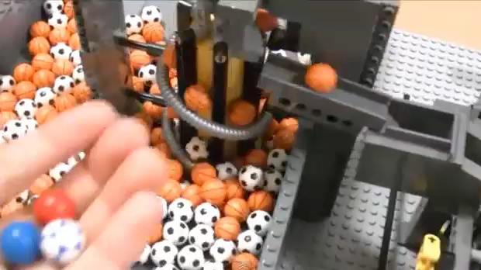
Research
Notes:
Encryption can be complex, or simple, but really it’s just a process.

Slide 16
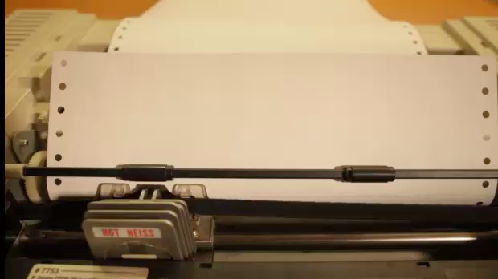
Communications
Notes:
Let’s start with communications as the first place to secure our data. We want to be sure that we aren’t leaking information to outsiders.

Slide 17
Communications
Notes:
You decide to start with communications. How can I ensure my data being transferred to clients is secure? How can I be sure the data between servers is secure?

Slide 18
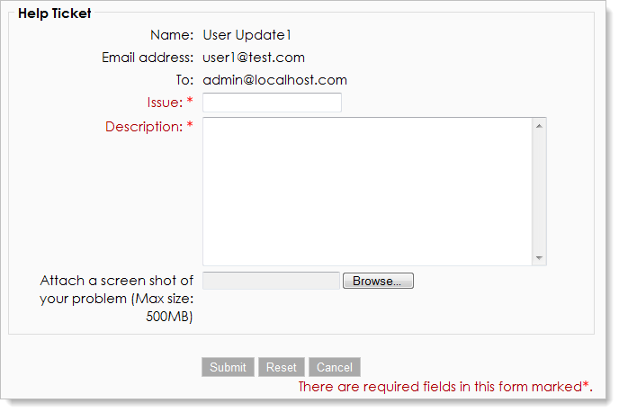
Communications
Configure ipsec
Configure ipsec between SQLDB01 and SQLDB02
Notes:
I can open a help desk ticket.

Slide 19

Communications
Notes:
And hope that the help desk understands and follows through.

Slide 20

Communications
Notes:
If I get IPSec, that will ensure I get communications from my machines in the data center secured.

Slide 21
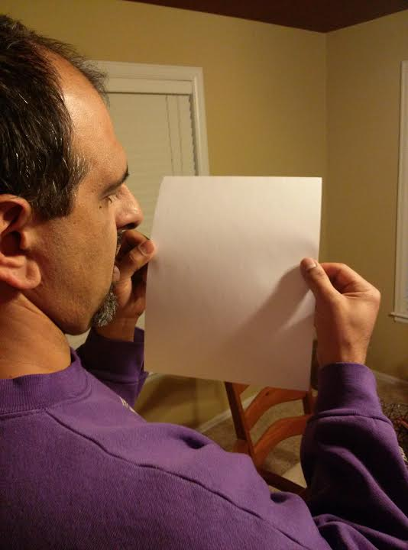
Communications
Purchase Certificate from Trusted Authority
Install Certificate on Windows
Enable certificate for SSL in SQL Server
Enable encryption for clients
Test
Notes:
I can look at SSL. The process for getting SSL integrated is fairly simple. I follow these steps. I purchase a certificate and install it on the Windows host for my SQL Server. I enable this inside SQL Server, enable it on the clients, and test things.

Slide 22
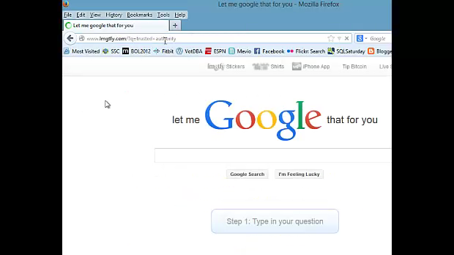
Communications
Notes:
If I don’t know what these things are, like a trusted authority, I can ask the Googles.

Slide 23
Communications
Notes:
Now I’ve got my communications secure.

Slide 24
Communications
IPSec
Windows layer
Windows administrators
SSL
Need purchased certificate
Simple Setup
Overhead?
Notes:
I’ve got these things enabled, I used IPSec at the Windows layer, inside my organization. For clients Iknow.
For outside communications, I Can use SSL.
Overhead for this encryption?

Slide 25


Communications
Notes:
Low. My phone isn’t ringing, so things are working fine.

Slide 26

Communications
Notes:
Time for a break.

Slide 27
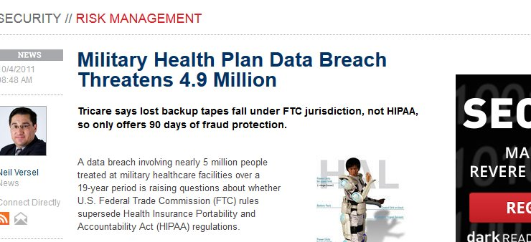
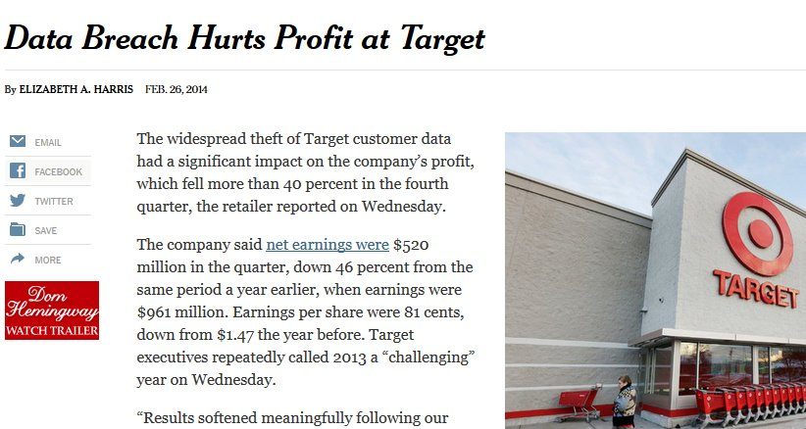
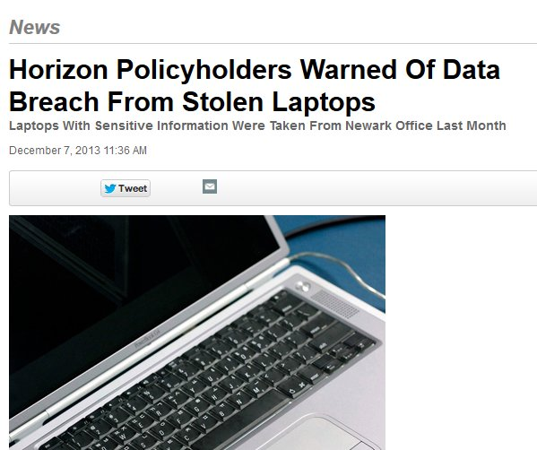
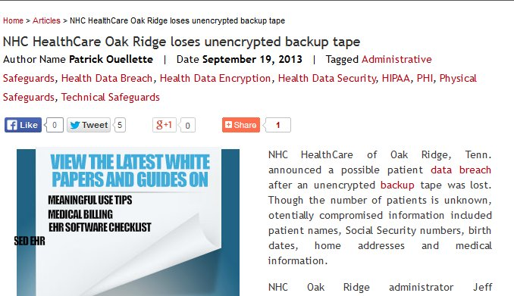
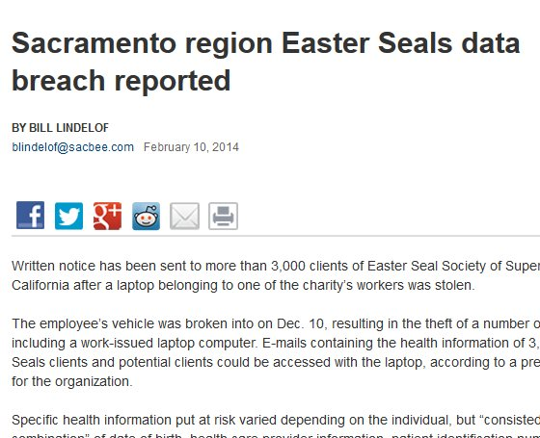
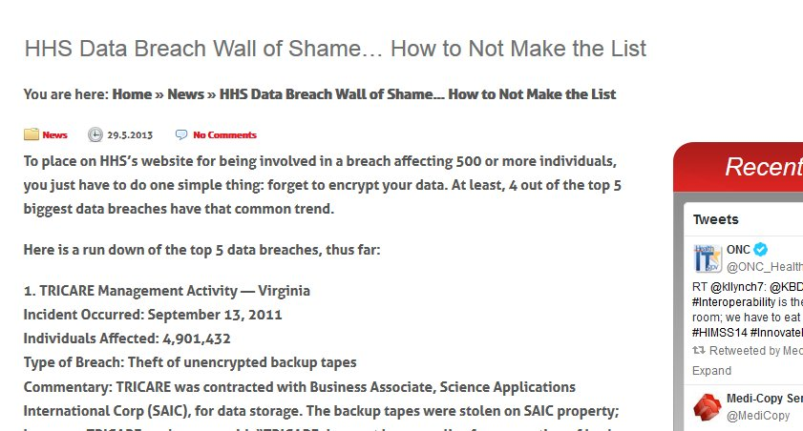
Data Loss
Notes:
Now I’m worried about all my data. I can securely transmit it, but I keep reading about all these data breaches.

Slide 28
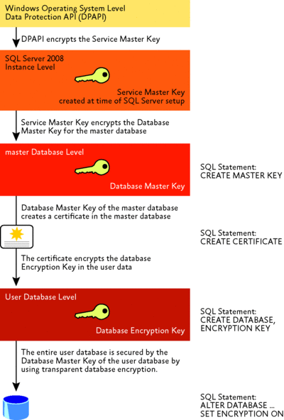
Transparent Data Encryption
Notes:
I decide to give TDE a try. I’ve heard it’s easy to set up. That’s a plus. I can see here, I need to create a key, then a certificate, then another key and turn encryption on.

Slide 29
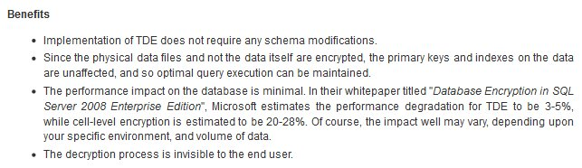
Transparent Data Encryption
Notes:
Why do this? (click)
There are two big advantages. No code changes, no schema modifications. Also, the process is invisible to the end used. That sounds simple.

Slide 30
Demo
Transparent Data Encryption
Setup and verification

Slide 31

Notes:
Time for another break

Slide 32

Wait
Notes:
Whoops, I’ve got problems.

Slide 33

Notes:
Our consultants have told me TDE isn’t enough. We have potential SQL Injection attacks that TDE doesn’t protect against and those could expose some of the PII data we have.

Slide 34
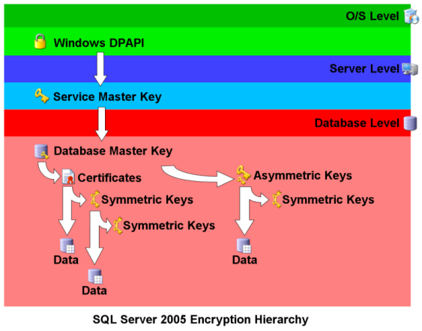
Column Encryption
Notes:
They tell me I need column level encryption on certain fields. I need to create these keys and use them to secure data.

Slide 35

Notes:
However I’ve heard this encryption can cause performance slowdowns. There are lots of calculations.

Slide 36
Bright Idea

Slide 37
Demo
Column Level Encryption
Partial Value Hash Buckets

Slide 38
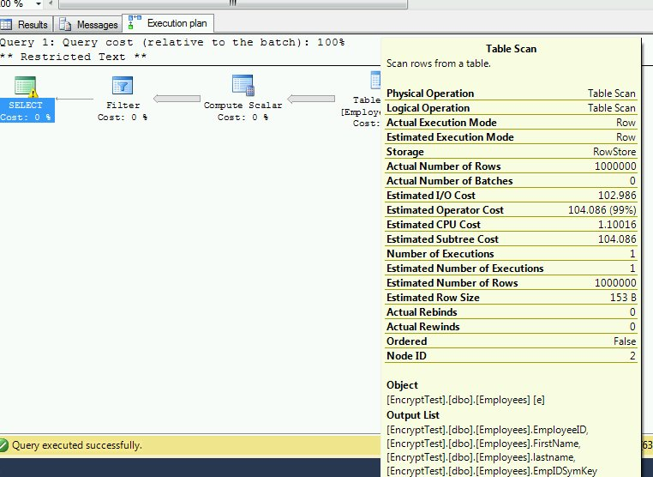
Symmetric Encryption

Slide 39
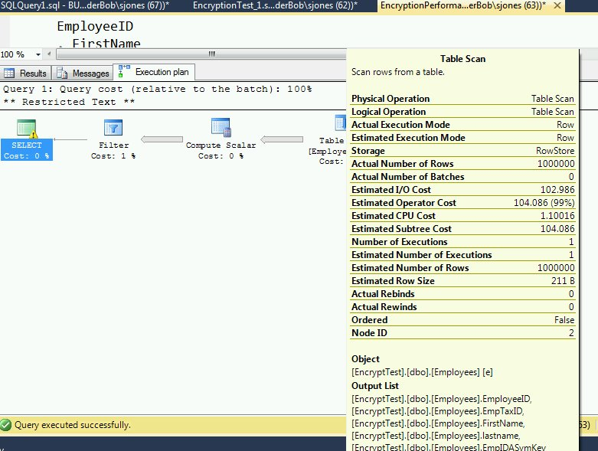
Asymmetric Encryption

Slide 40
Final Comments
Encryption is complex
Secure communications with SSL or IPSEC encryption
Both fairly low impact.
IPSEC – Windows Admin
SSL – Windows + SQL Admin
Transparent Data Encryption
At rest encryption of data and backups
No protection from authorized users
Use whole disk encryption on laptops
Column Encryption
Use hash buckets for performance
Need a good bucket value that can be chosen ahead of time

Slide 41


Questions?
Don’t forget to complete an online evaluation on EventBoard!
Session: SQL222
Protecting your data with encryption while maintaining
Performance in SQL Server 2014
Your evaluation helps organizers build better conferences, and helps speakers improve their sessions.
Thank you!
@way0utwest (Twitter)
http://www.linkedin.com/in/way0utwest
www.voiceofthedba.com
SQLServerCentral (sjones@)

Slide 42
References
Encryption Formulas - http://math.tut.fi/~ruohonen/MC.pdf
Trusted Authority – Let Me Google That For You - http://www.lmgtfy.com/?q=trusted+authority#
SSL
Enable SSL - http://support.microsoft.com/kb/316898
IPSec v SSL Tunnel -http://searchsecurity.techtarget.com/feature/Tunnel-vision-Choosing-a-VPN-SSL-VPN-vs-IPSec-VPN
Technical comparison - http://eprint.iacr.org/2004/314.pdf
StackExchange discussion - http://security.stackexchange.com/questions/14334/when-is-it-appropriate-to-ssl-encrypt-database-connections
TDE
TDE - http://technet.microsoft.com/en-us/library/bb934049.aspx

Slide 43
References
TDE
TDE - http://technet.microsoft.com/en-us/library/bb934049.aspx
TDE - https://www.simple-talk.com/sql/database-administration/transparent-data-encryption/
Encryption
SQL Server Encryption - http://technet.microsoft.com/en-us/library/bb510663.aspx
Voice of the DBA – Encryption - http://voiceofthedba.wordpress.com/tag/encryption/
Chris Bell – Encryption - http://wateroxconsulting.com/archives/category/sql/encryption
http://dpatrickcaldwell.blogspot.com/2010/10/sql-server-encrypted-columns.html
http://cappris.inria.fr/wp-content/uploads/2013/04/Benjamin-Nguyen.pdf
http://research.ijcaonline.org/volume41/number4/pxc3877580.pdf
Tamper evident encryption of integers using keyed Hash Message Authentication Code - http://www.google.com/url?sa=t&rct=j&q=&esrc=s&source=web&cd=10&ved=0CHcQFjAJ&url=http%3A%2F%2Fcs.uccs.edu%2F~gsc%2Fpub%2Fmaster%2Fbbaker%2Fdoc%2Fbbaker_project_report.doc&ei=uClIU7X0GKWEyAGrmYCACA&usg=AFQjCNHlSM8Fdm0Y6nFlPmXR7qAeSimtEA&sig2=GcRH-t-ww7MIw73LLNz9xw&bvm=bv.64542518,d.aWc

Slide 44
Images/Video
Adding Machine - https://www.youtube.com/watch?v=Pi4sH2R5tAs
Complex Machine Video / Lego Balls - https://www.youtube.com/watch?v=sUtS52lqL5w
Encryption functions - http://math.tut.fi/~ruohonen/MC.pdf
Matrix Gif 1 - http://red-pill.org/wp-content/uploads/2011/04/matrix-animated-image.gif
Matrix Gif 2 - http://i.imgur.com/Y9FXFKQ.gif
Trouble Ticket sign - http://i.imgur.com/685Hq.jpg
Dot Matrix Printer – http://vimeo.com/58200103
Trouble Ticket form - http://manuals.moodlerooms.com/download/attachments/2589228/TRTB_V1_help+ticket_2011020200.png?version=3&modificationDate=1296693637000

Slide 45
Images/Video
Starbucks - https://instoredoes.s3.amazonaws.com/images/blog/foam_thumb.jpg
Spill - http://thefamilyjules.com/wp-content/uploads/2009/11/spilled-starbucks.jpg
Iphone - http://media02.hongkiat.com/iphonewp/iphone-wallpaper-by-2createmedia.jpg
TDE - http://i.technet.microsoft.com/cc434691.fig01%28en-us%29.gif
Encryption - http://www.sqlservercentral.com/columnists/mcoles/SQL2K5Enc.png
Office Space consultants - http://marcfrankmontoya.com/wp-content/uploads/2011/11/Office-Space-homies4.png

